Slide 1

Web scraping to gain company insights
06/06/2023

Slide 2
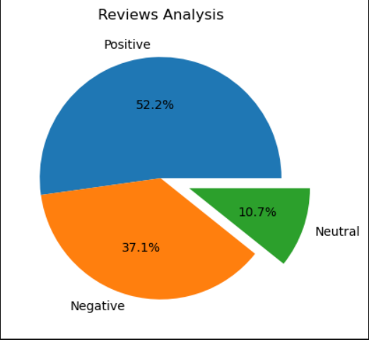
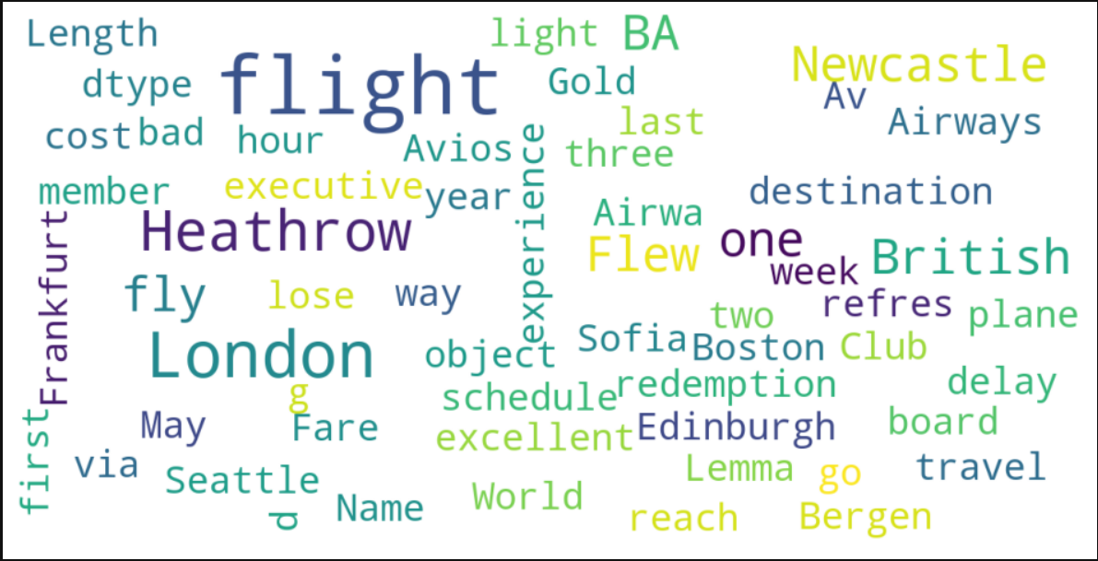
INSIGHTS FROM CUSTOMER REVIEWS
From cleaning 1400 reviews given by the customers, we obtained
Positive Reviews - 731
Negative Reviews - 519
Neutral Reviews – 150
Word cloud of keywords used in reviews

